Slide 1
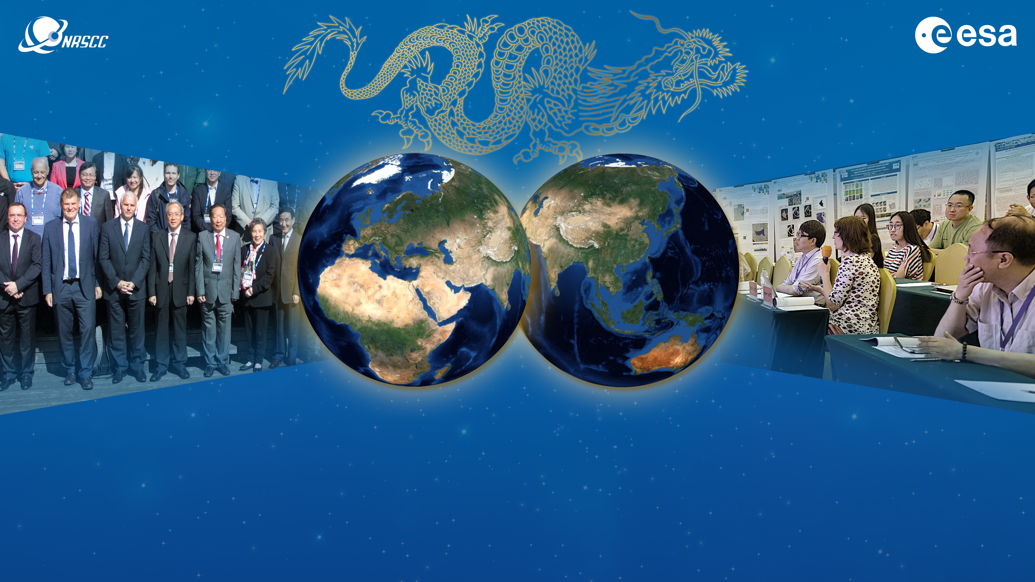
DRAGON 2021 SYMPOSIUM
Dragon 5 1st Year Results Reporting
21 to 23 July 2021

Slide 2

<INSERT DAY & DATE in PROGRAMME>
Dragon 5 ID. xxxxx
PROJECT TITLE:
PRINCIPAL Investigators project summary presented By [NAME]
List PIs

Slide 3
Dragon 5 1st year results reporting
** IMPORTANT **
If you are presenting your project’s results after 1 year of activity please present the following and include EO data delivery: (or go to slide 5)
Inform on the project’s objectives
Detail the Copernicus Sentinels, ESA, Chinese and ESA Third Party Mission data utilised after 1 year (complete slide 4)
Detail the in-situ data measurements and requirements
Provide details on field data collection campaigns and periods in P.R. China or other study areas
Inform on the results after 1 year of activity
Inform on the project’s schedule, planning & contribution of the partners for the following year
Inform on the level and training of young scientists on the project, including plans for academic exchanges

Slide 4
EO data delivery
Data access (list all missions and issues if any). NB. in the tables please insert cumulative figures (since July 2021) for no. of scenes of high bit rate data (e.g. S1 100 scenes). If data delivery is low bit rate by ftp, insert “ftp”
ESA Third Party Missions | No. Scenes
1.
2.
3.
4.
5.
6.
Total:
Issues:
ESA, Explorers & Sentinels data | No. Scenes
1.
2.
3.
4.
5.
6.
Total:
Issues:
Chinese EO data | No. Scenes
1.
2.
3.
4.
5.
6.
Total:
Issues:

Slide 5
Dragon 5 project presentation
** IMPORTANT **
If you are presenting your Dragon 5 project please present the following:
Inform on the project’s objectives
Detail the Copernicus Sentinels, ESA, Chinese and TPM data to be investigated
Inform on the project’s schedule, planning & contribution of the partners
Indicate the level and training of young scientists on the project
Detail the in-situ data measurements and requirements
Provide details on expected field data collection campaigns and periods in P.R. China, in Europe or elsewhere
Inform on the expected results

